Slide 1
Inventory Management System Project
By Andi Berisha

Slide 2
Introduction
About Me:
I’m Andi and I am a QA digital consultant trainee.
Approach:
Studied the project specification thoroughly.
Studied the starter and tried to infer the function of the application based on its code architecture.
Used Stack Overflow and the trainers to deal with various errors and problems throughout the project.

Slide 3
Consultant Journey
Technologies learned and used for this project:
Maven
Git
MySQL WorkBench
Java with the IDE Eclipse
Jira
Google Cloud Platform
Junit

Slide 4
Continuous Integration
Employed the feature-branch pattern in order to obtain a clear insight into the project progress and development.
Ensured no merge conflicts occurred by using the simplified Github in-browser pull request methodology.
Used various build tools through maven.
Made commits at least twice a day.

Slide 5
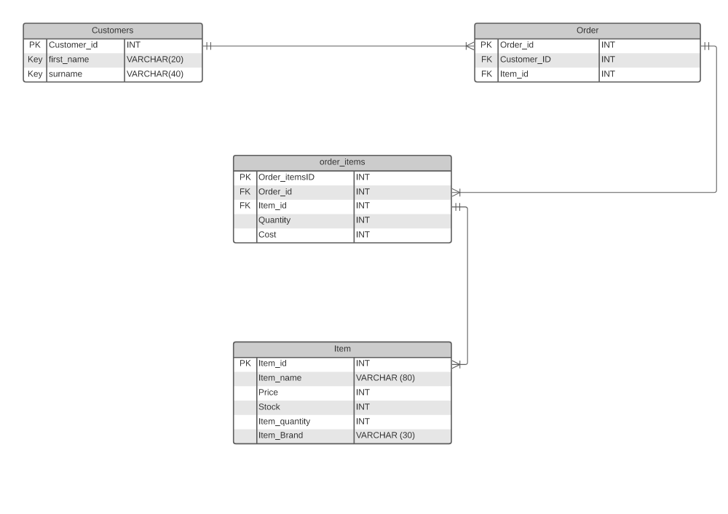
Entity Relationship Diagram
The ERD pictured below was utilised for this project:
Notice how the order_items table accounts for
the many to many relationships between order and
Item.

Slide 6
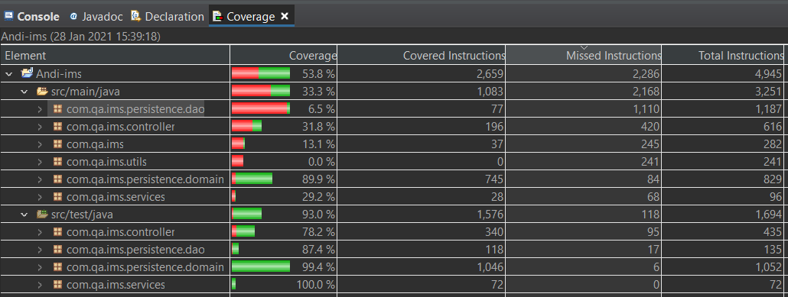
Testing
Testing Coverage Amount:

Slide 7
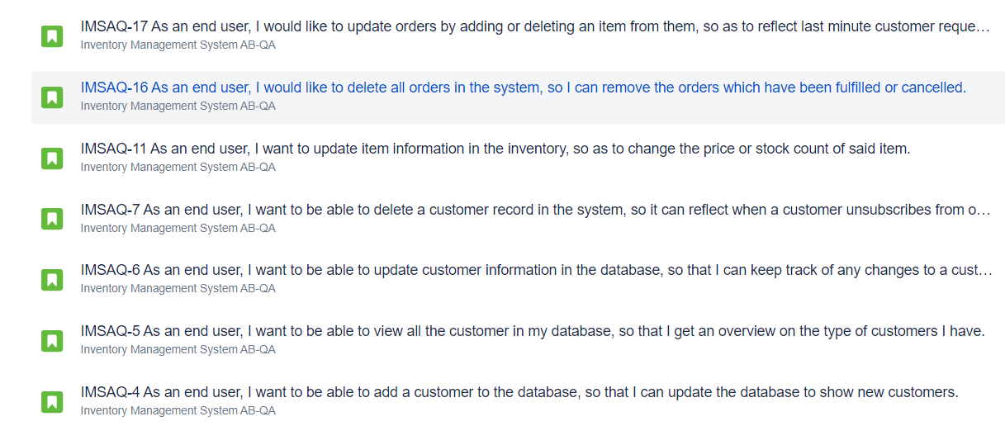
User Stories Demonstration
Now I will demonstrate several user stories some of which are pictured below:

Slide 8
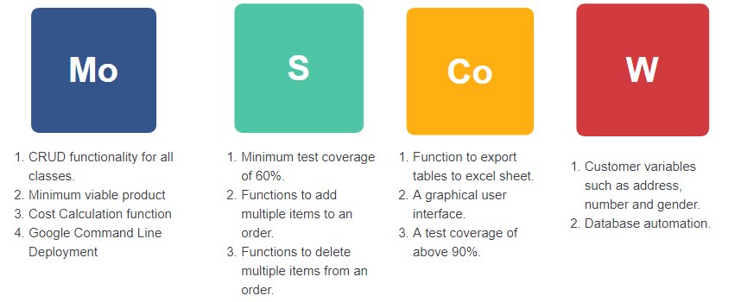
Sprint Review
Project Start MoSCoW

Slide 9
Sprint Retrospective
Items Completed:
Produced minimum viable product.
Fat .jar runs from the command line.
Thorough Documentation has been provided for the project.
Items Uncompleted:
Barely any test coverage achieved
SonarQube was not utilized
Code organisation was lacking in some classes like order.

Slide 10
Conclusion
Project was successful (minimum viable product has been delivered)
Project enabled me to utilise all the knowledge from the last few weeks and truly get to grips with the syntax and class interactions.
Confidence slowly grew throughout the project.
However, due to personal and medical issues I lost many vital days which could have been utilized to great effect by communicating with trainers and trying to fill all the holes in my java knowledge.
Could have achieved a significantly better project quality if I wasn’t impeded by personal circumstances.
Disappointed with my performance in this project as it is not a true reflection of my actual ability.
Will definitely continue to work on this project in the near future as I want to achieve a quality I am actually happy with.

